Slide 1

TNO: Applied research organization

Slide 2
BIMserver.org “project”:
BIMserver.org mission is to help all actors in the Architectural, Engineering and Construction (AEC) industry to collaborate more efficiently and effectively (and thereby creating better buildings for lower costs).
BIMserver.org goal is to create the most favorite software platform for collaboration in the AEC-industry.
http://bimserver.org/about/philosophy/

Slide 3
BIMserver Strategy:
Mission: help AEC to collaborate more efficiently and effectively
+
Position: Not software vendors
Creating a platform for others to build on top / extend;
No direct end-users;
Creating a snowball effect;
=
Goal: create most favorite platform by lowering the threshold for developers of niche applications
=
Mission: help AEC to collaborate more efficiently and effectively

Slide 4
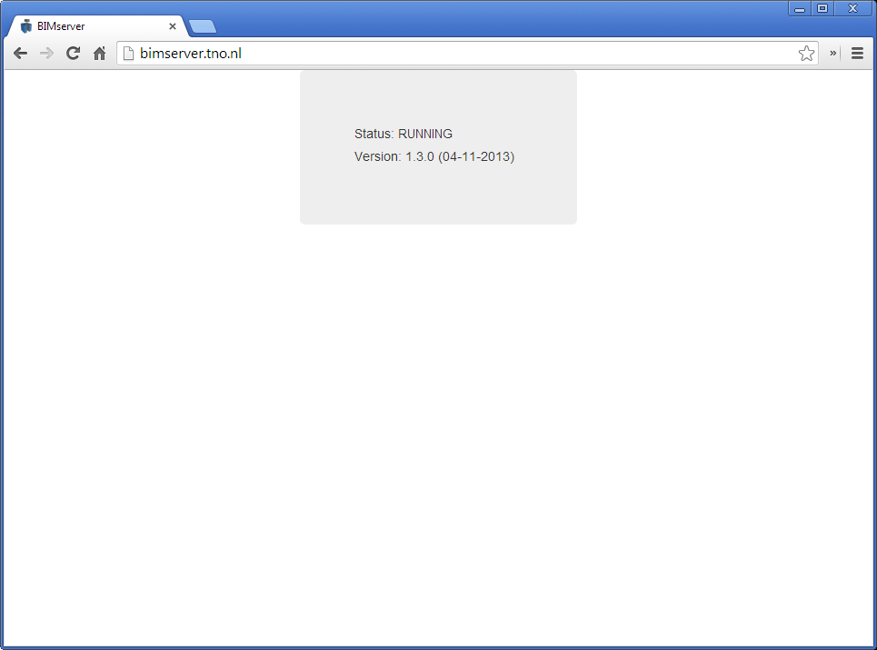
How a ‘platform’ looks….

Slide 5
What BIMserver is….
Open and stable core to use and build on top
Core server features like revisions, authorization, compare, query, merging, etc..
Open interfaces, lots of network protocols (soap, PB, json)
Open standards
Plugin framework for render engines (like IfcOpenShell); ObjectIDMs & Query engines (like BimQL)
Flexible admin configuration & fine-tuning
Open source
Good developers documentation
Etc..

Slide 6
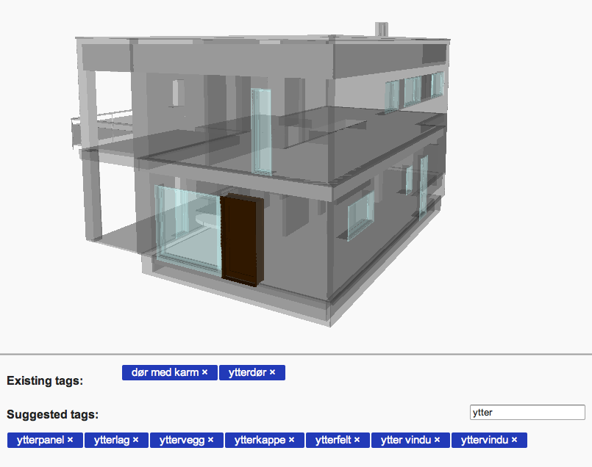
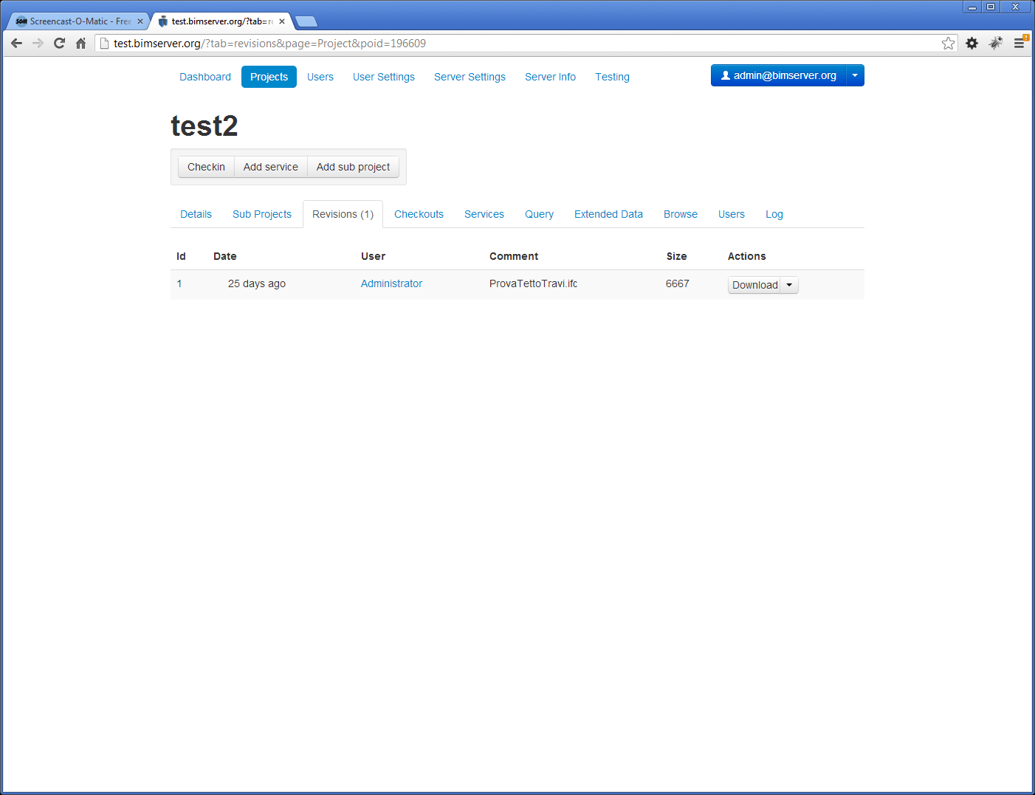
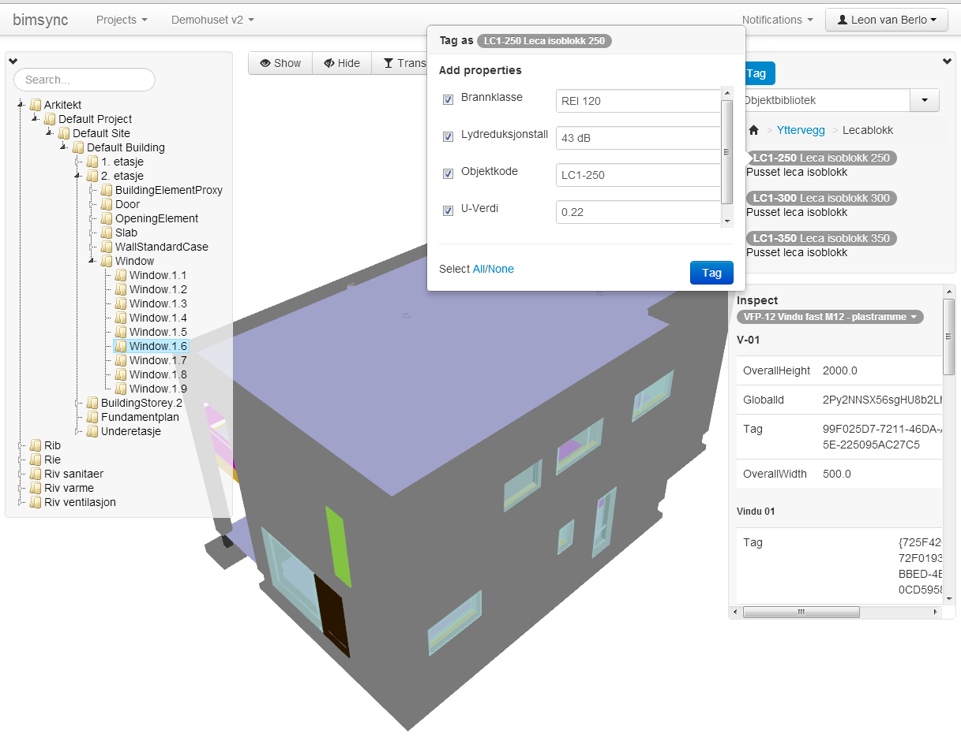
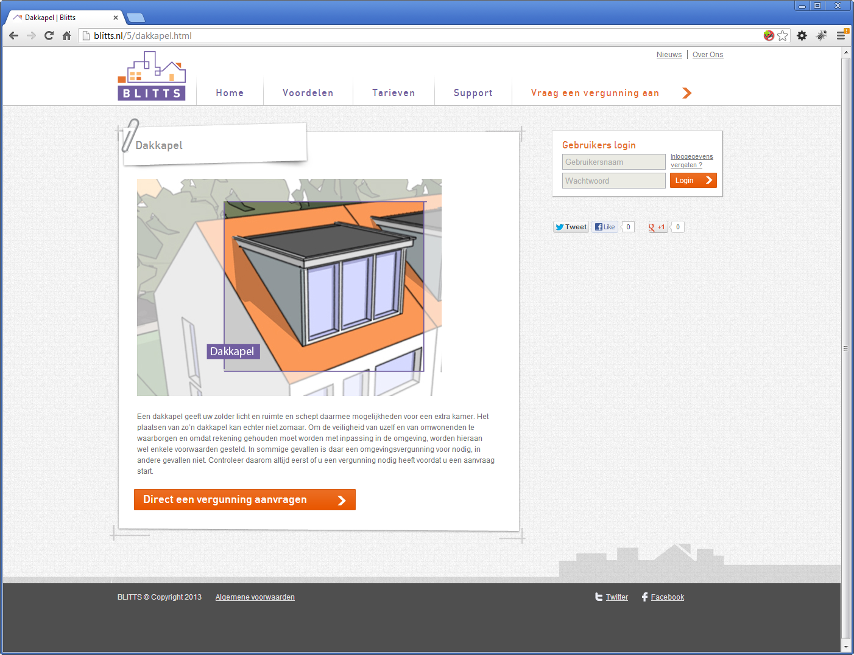
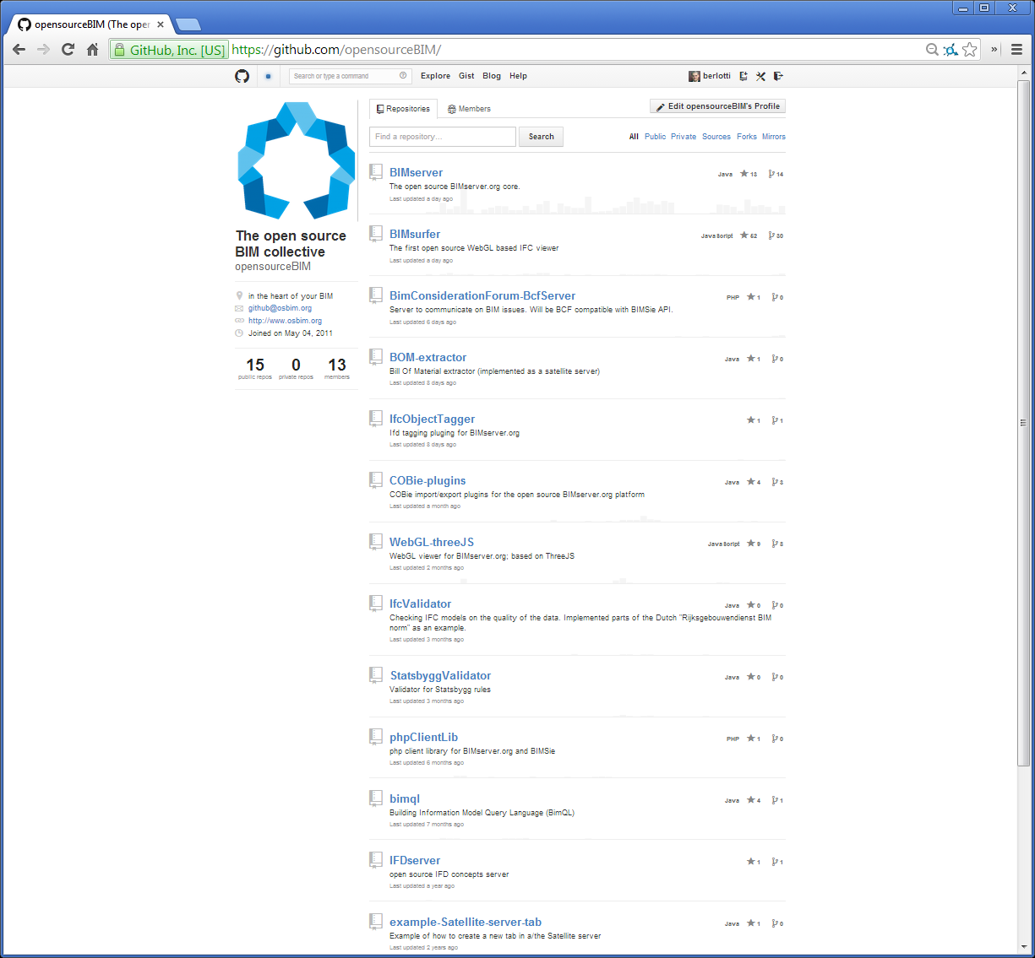
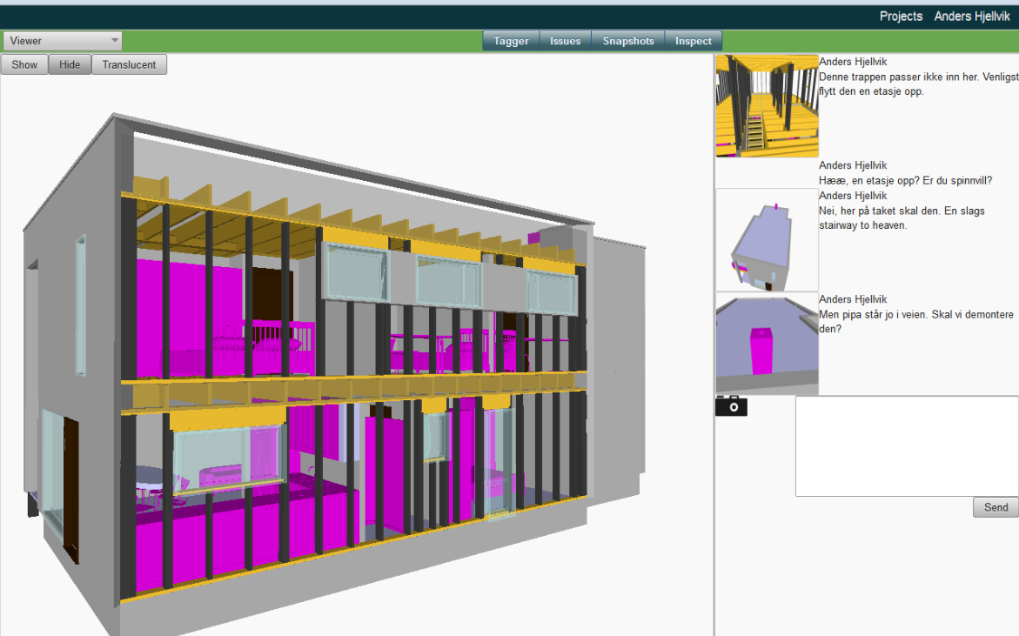
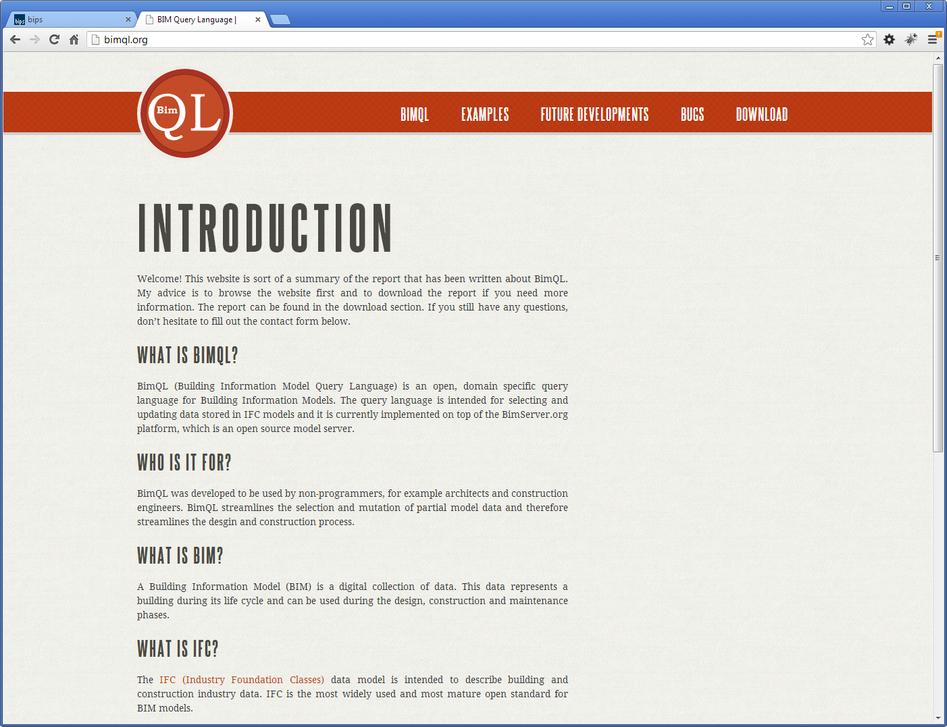
What people are building…..

Slide 7


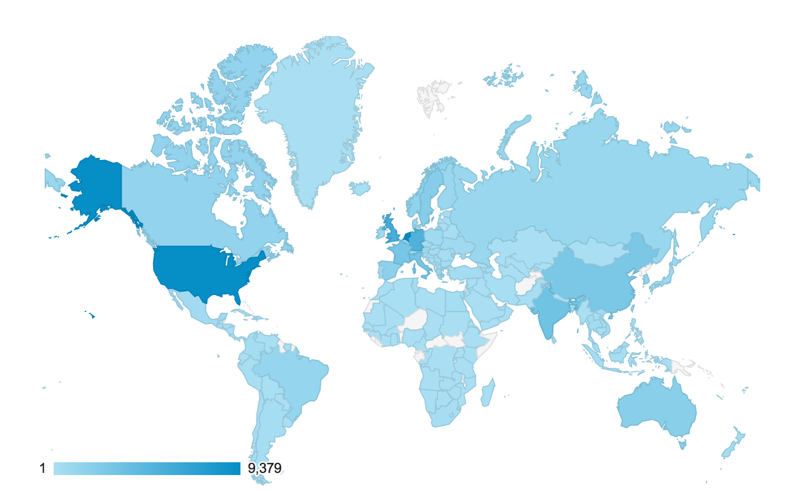
A community
+/- 150 developers on community
> 4000 bimserver users in 2012*
> 5000 downloads since 1.0
Around 6000 unique site visitors/month
Great user testimonials
* That we know of because they send us statistics

Slide 8
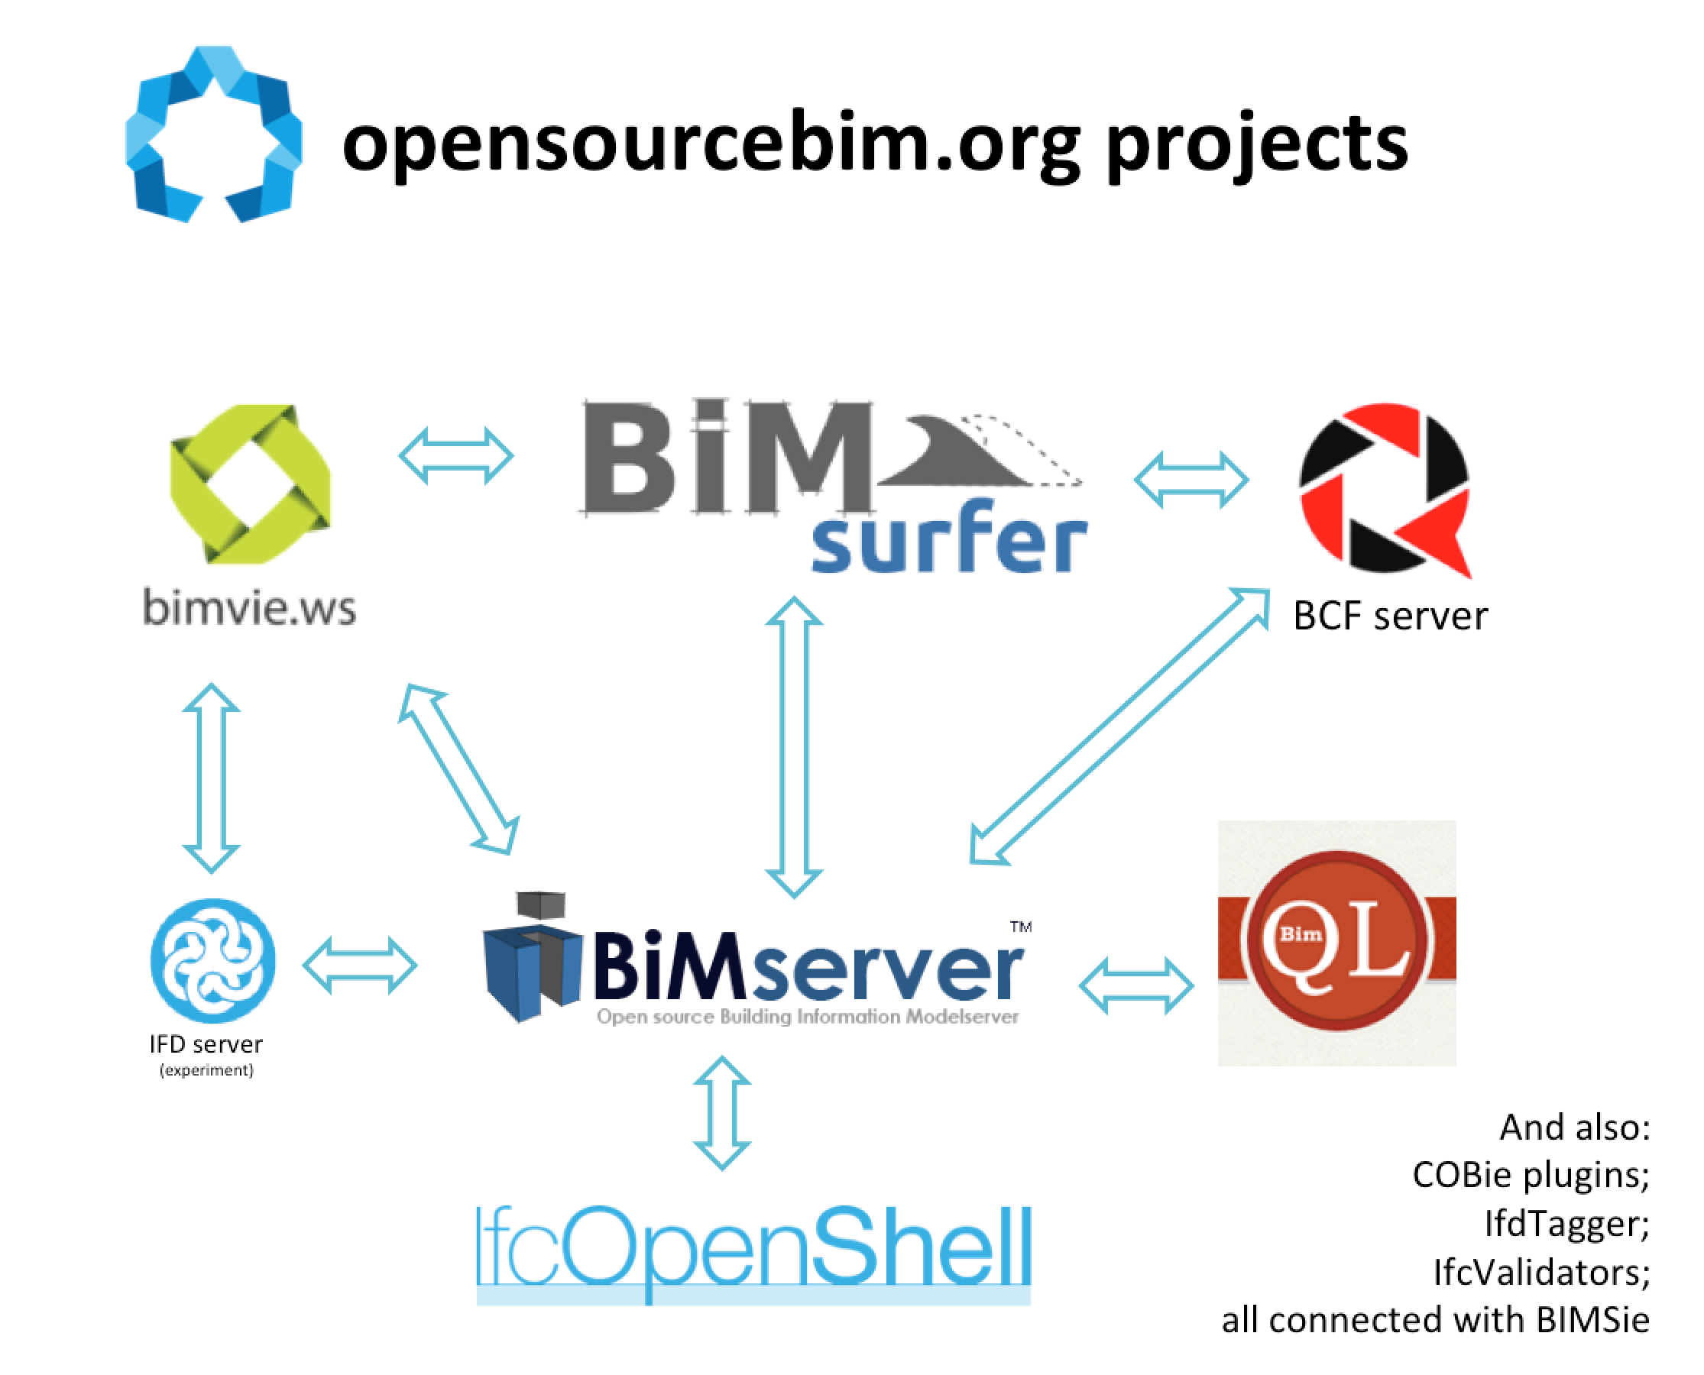
What are we working on?

Slide 9
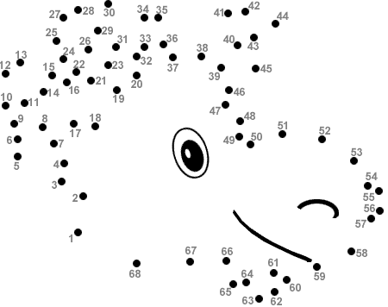
“Get the information flowing”

Slide 10
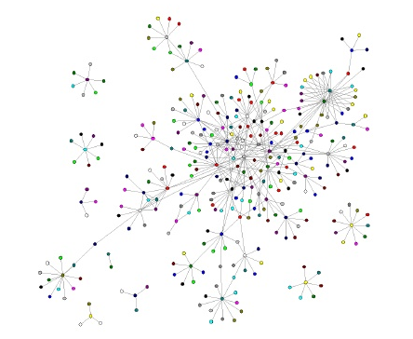

Slide 11
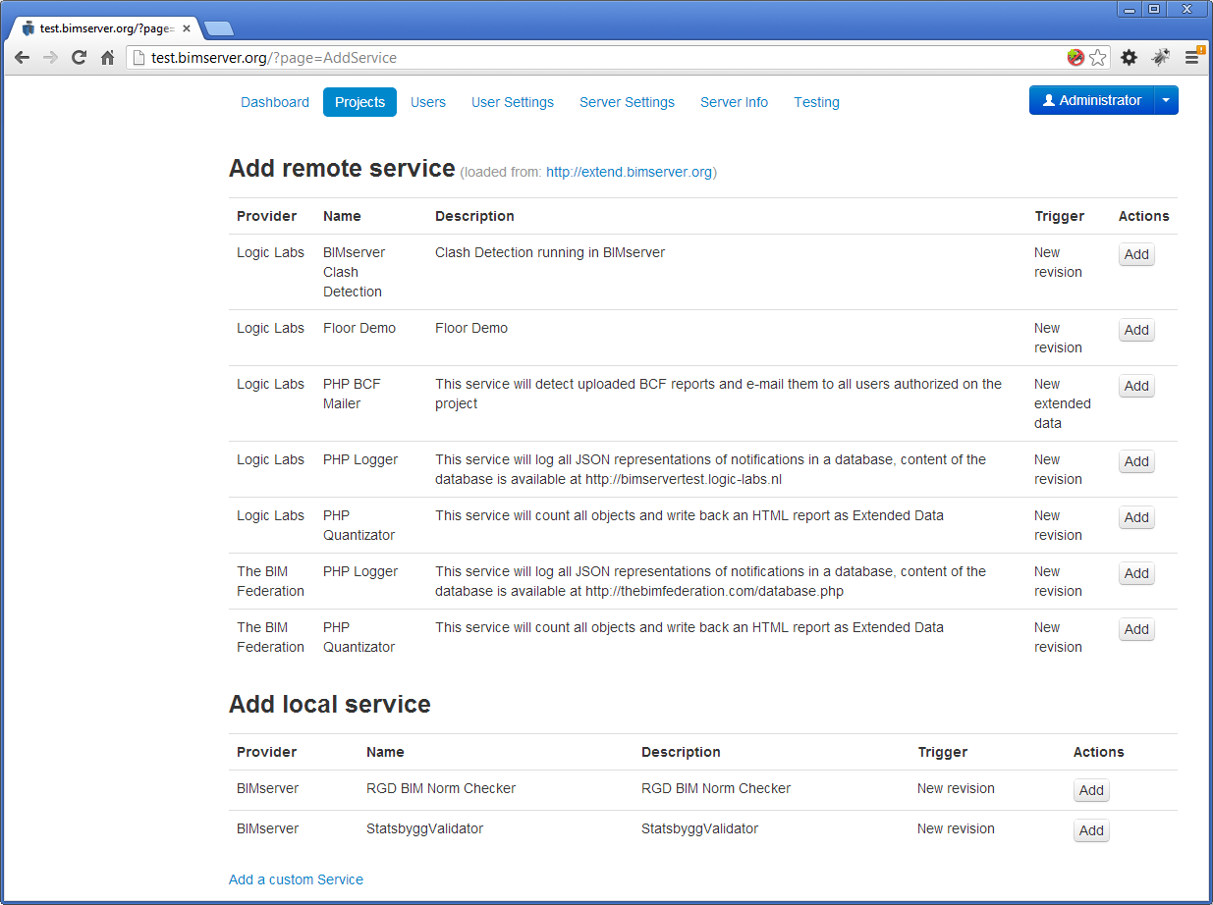

Slide 12
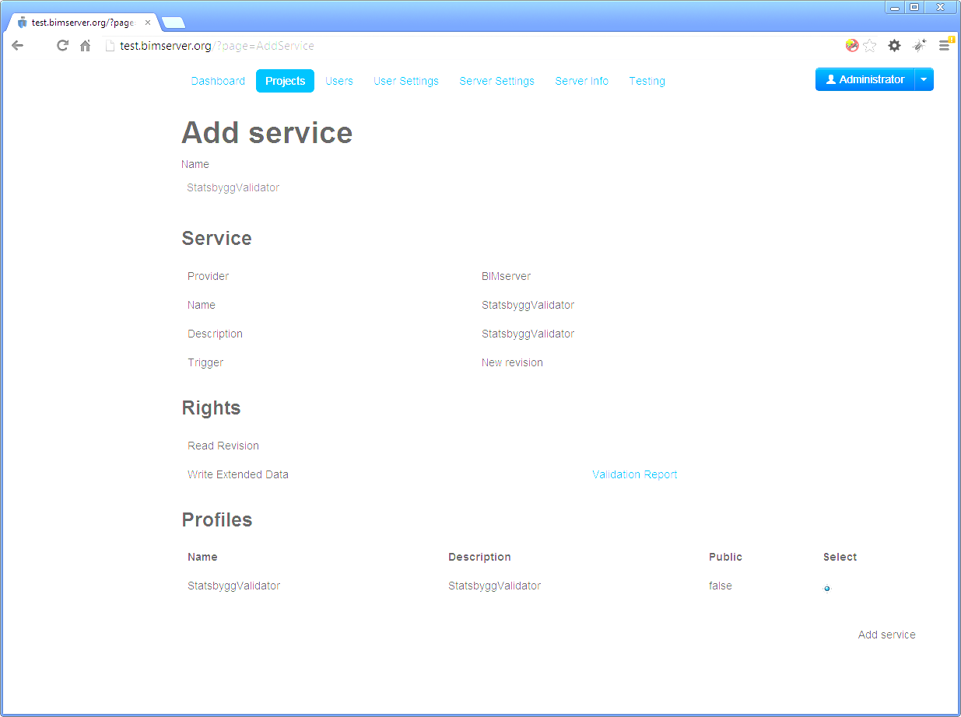
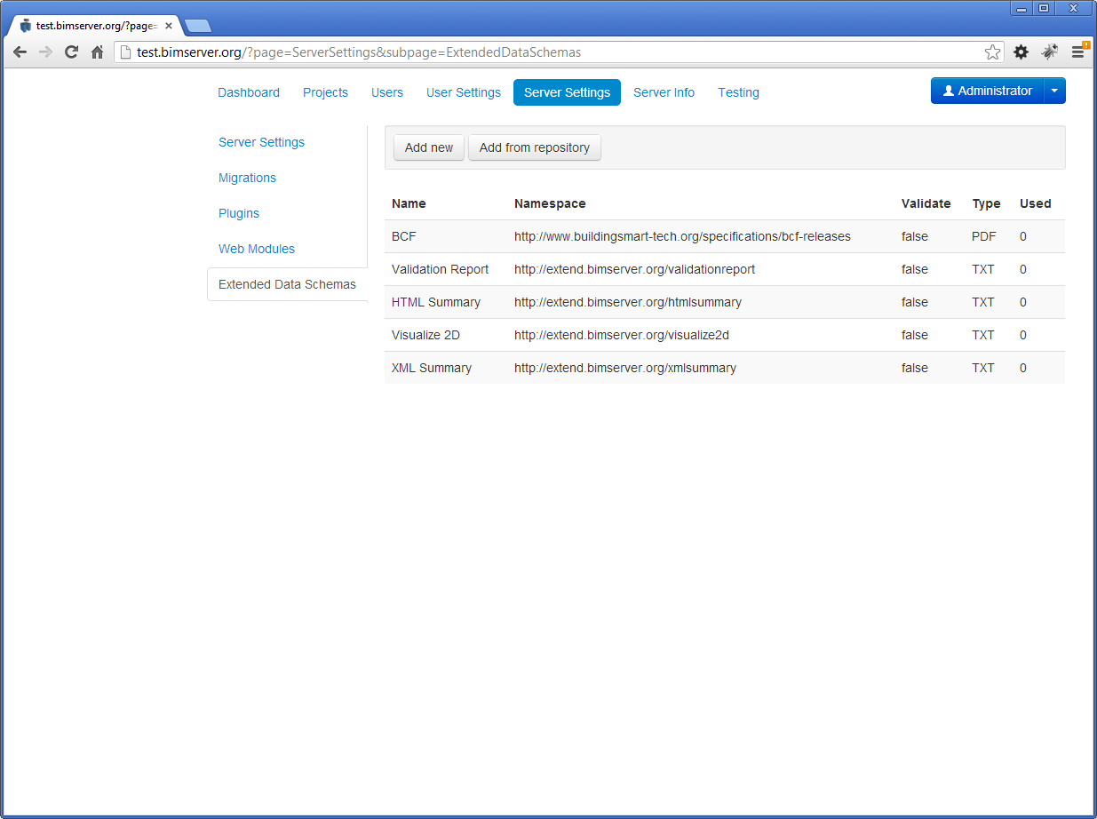
Modelchecking

Slide 13
Niche applications
‘remote’ services like:
Clashdetection
CO2 life cycle calculation
Supplier automators (staircase, floors,etc)
Android app
Loggers and analyses
Validation checkers
BOM extractor
Furniture placer
SpaceInvaders app
PNG renderer
2D Floorplan generator
….
Everything automatic and ‘on demand’ event driven

Slide 14
Current demonstrator
1. Checkin model (bimserver)
- Staircase supplier sends staircase model (IFC)
- Floorsupplier(IFC)
- Innerwall supplier (IFC)
2. Clashdetection (BCF)
3. Check on IFC quality (Statsbygg / RGD)
4. CO2 life cycle analyses (PDF)
2. Sync with datastore of projectmembers
4. Client gets COBie model update for FM in dropbox

Slide 15
Remote services
Can be closed source / ask money for specific features (profiles)
Based on publish/subscribe principle (subscription to events)
Can be more than one per topic (competition)
Is centralized for the service provider
This:
Creates a new market for niche appliations
Gets BIM into the web
Takes advantage of the fragmented nature of the industry
Is an open approach instead of getting everything on one black box: crucial is to standardise the API between services

